Slide 1



EMOTION RECOGNITION OF GOLDEN RETRIEVER USING DEEP LEARNING
Paper ID: ICCoSD25-662
Presenting Author :
Veekshitha Adharasani
Co-Authors:
Dr. Sridhar Chintala , Dr. Deep Shekhar Acharya , Rida Shireen
1

Slide 2
Table of Contents
Introduction & Motivation
Objective & Problem Statement
Challenges in Dog Emotion Recognition
Methodology
Model Architecture
Results & Analysis
Comparison with Existing Work
Conclusion & Future Work
2
2

Slide 3
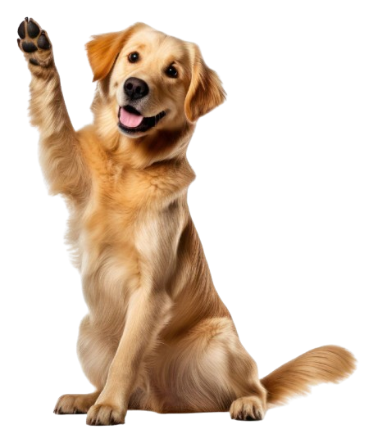
| Introduction and motivation
Introduction
Dogs express emotions such as happiness, sadness, and anger.
These emotions affect their behavior, health, and human connection.
Golden Retrievers are known for their expressive nature.
Facial expressions can provide an indication of their feelings.
Motivation
Observing the emotions of your pet keeps them safe and happy.
Understanding their emotions strengthens the connection between you and your pet.
If you read their emotions wrong, it may lead to stress or trouble for both of you.
3
2

Slide 4
| Objective and Problem Statement
Objective of the Research
Problem Statement
To develop an emotion recognition model that categorizes the emotions of Golden Retriever dogs through deep learning.
It Classifies the emotions into 3 categories:
Make the system simple, accurate, and useful for real-world pet care through the use of images only.
Why its difficult?
Dogs express emotions by subtle facial and body changes, which are not easy to observe.
A model developed for various dog breeds may not be as effective for Golden Retrievers.
Why it matters!
This can assist in pet care, interpreting how pets feel, and designing intelligent systems that react to how dogs feel.
Happy
Sad
Angry
4
2

Slide 5
| Challenges in Dog Emotion Recognition
Challenges Faced
Subtle facial cues: Dog emotions are hard to spot in still images.
Breed differences: Emotions look different across breeds.
No standard dataset: Most datasets mix breeds or emotions.
Need for a model that works only on Golden Retrievers
5
2

Slide 6
| Methodology
Dataset Preparation
Custom dataset created with 900 labeled images of Golden Retrievers in 3 classes – Happy, Angry, Sad.
Augmentation techniques:
Rotation, flipping, zoom, brightness variation.
Final dataset:
Split into 80% training and 20% testing.
Model Architecture
We experimented with 4 models:
CNN
CNN + Simple RNN
MobileNetV2
CNN + LSTM (Proposed Model)
6
2

Slide 7
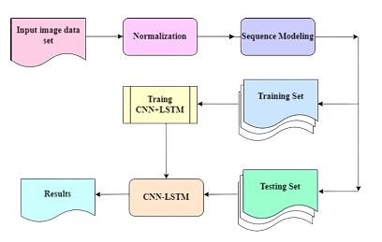
| Methodology
Proposed Model : CNN+LSTM
CNN block (MobileNetV2) used for spatial feature extraction.
LSTM layers added for learning potential temporal patterns or to prepare for future video-based input.
Fully connected layer for classification into 3 emotion categories.
Training Setup
Optimizer: Adam
Learning Rate: 0.0005
Loss: Categorical Cross-entropy
Batch Size: 32, Epochs: 30
Used 5-Fold Cross-Validation for performance consistency.
7
2
Fig1 - Block diagram of CNN+LSTM approach

Slide 8
| Model Architecture
Model Architectures Used
CNN (Baseline Model)
Convolution → ReLU → MaxPooling.
Fully Connected → Softmax.
Suitable for spatial pattern recognition.
MobileNetV2
Lightweight, efficient model trained on ImageNet
Used as a feature extractor
Global Average Pooling → Dense → Softmax
CNN + Simple RNN
CNN for feature extraction
RNN layer for basic sequential feature learning
Helps identify slight transitions in expressions.
Proposed Model: CNN + LSTM
MobileNetV2 for feature extraction
LSTM layers added to model temporal relations
Fully Connected → Dropout → Softmax
8

Slide 9
| Results & Analysis
Model Comparison Table
Proposed Model Evaluation Table (CNN+LSTM)
 | Model | Accuracy | Precision | Recall | F1_Score
1 | CNN+LSTM | 0.8681 | 0.8728 | 0.8681 | 0.8679
2 | CNN+RNN | 0.8167 | 0.3305 | 0.3278 | 0.3252
3 | CNN | 0.8278 | 0.8395 | 0.8278 | 0.8238
4 | MobileNetV2 | 0.8389 | 0.8224 | 0.8222 | 0.8216
Metric | Value
Accuracy | 86.81%
Precision | 87.28%
Recall | 86.81%
F1 score | 86.79%
Key Observations
CNN + LSTM had the highest accuracy
LSTM helped in capturing subtle emotional patterns
MobileNetV2 showed strong performance due to transfer learning
CNN + RNN performed less accurately than expected
9
2

Slide 10
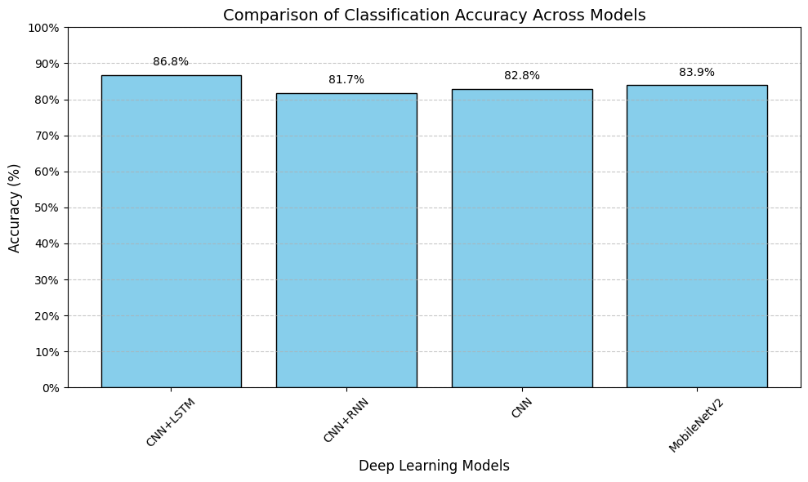
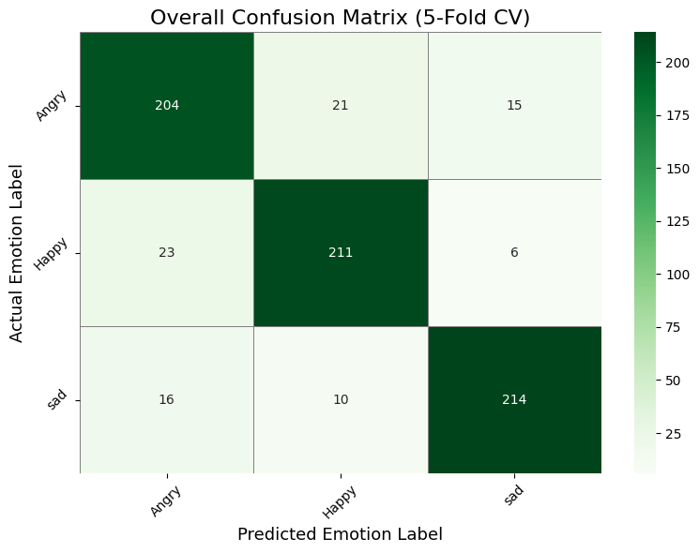
| Results
Fig2 - Comparison of the accuracy of CNN+LSTM with existing methods
Fig3 – Confusion matrix of the proposed CNN+LSTM
10

Slide 11
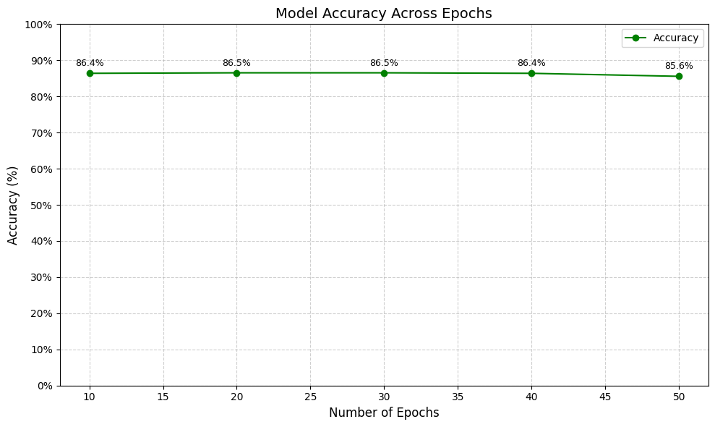
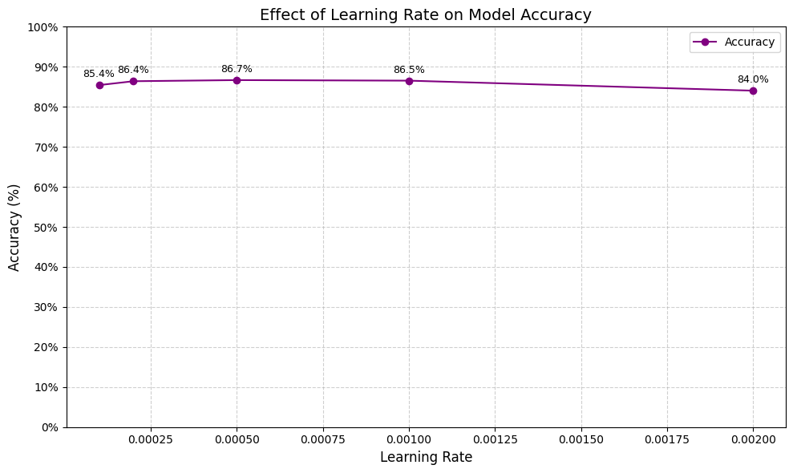
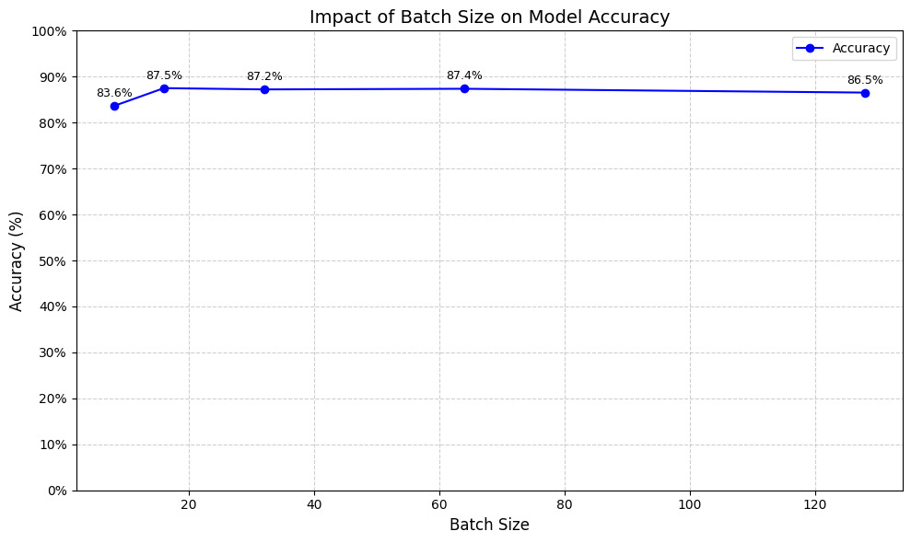
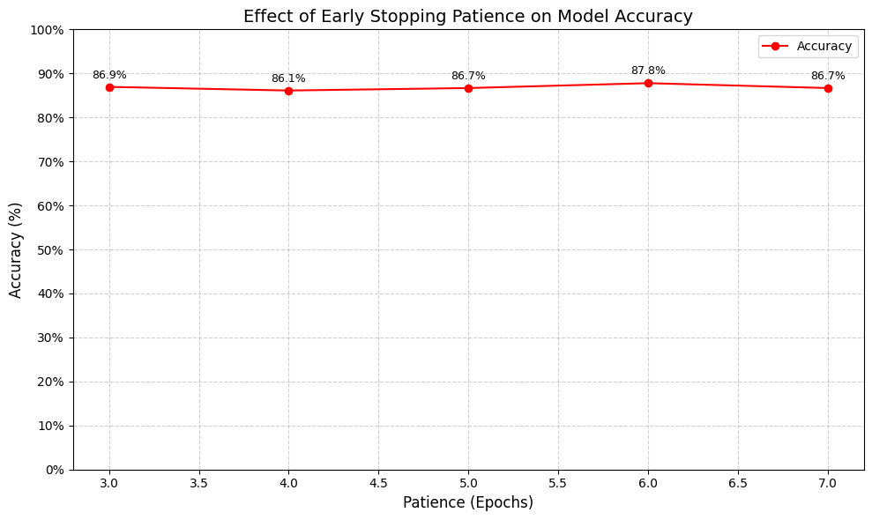
Fig4 – Accuracy vs Epochs of CNN+LSTM
Fig5 – Accuracy vs Learning Rate of CNN+LSTM
11
Fig6 – Accuracy vs Batch Size of CNN+LSTM
Fig7 – Accuracy vs Patience of CNN+LSTM

Slide 12
| Comparison with Existing Work
Our Contributions
Existing Work
A CNN + LSTM hybrid was proposed, which is specific to Golden Retriever dog emotions.
Compared performance with baseline models: CNN, CNN+RNN, MobileNetV2 and the proposed CNN+LSTM
Used custom dataset with data augmentation to handle limited data.
Cross-validation applied for more reliable evaluation
The majority of emotion recognition research applies to humans through facial features or voice.
Little work has been done on dog emotion recognition, particularly breed-specific.
Basic CNNs are employed in some models with decent accuracy (~70–80%) on data.
12

Slide 13
| Conclusion and Future Work
Conclusion:
Trained a deep learning model to recognize Golden Retriever emotions (Happy, Sad, Angry)
Employed CNN, CNN+RNN, MobileNetV2, and CNN+LSTM
Best accuracy: 86.8% with CNN + LSTM
Image-based approach - non-invasive, feasible for actual application.
Future Work:
Deploy the model on real-time video input.
Implement Grad-CAM for visual interpretability
Create a mobile or IoT application for emotion recognition.
13

Slide 14
Thank you
Veekshitha Adharasani
+91 9391049895
veekshithaadharasani@gmail.com
14

